Slide 1
EOHS – Numbers, Boundary and Occupation

Slide 2
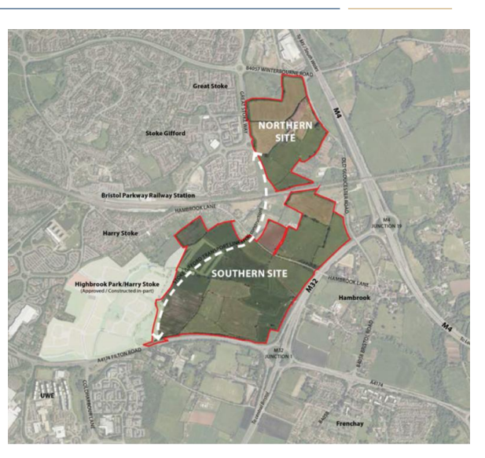
Site Pic

Slide 3
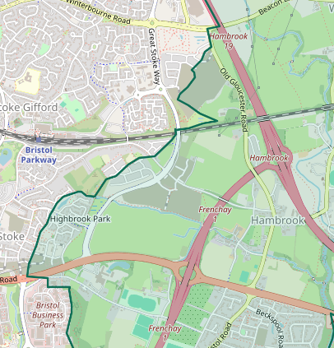
WPC Boundary

Slide 4
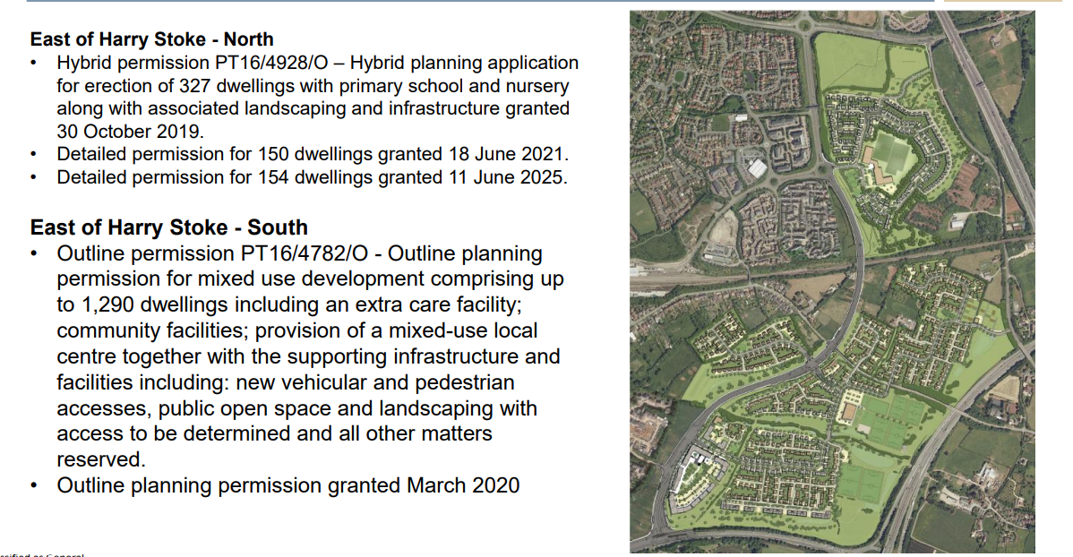
East of Road – Planned properties

Slide 5
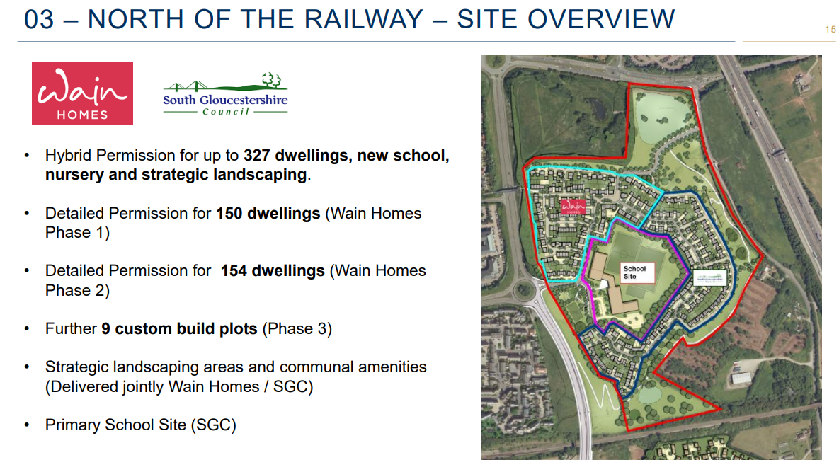

Slide 6
Update on current occupancies
North of Railway (Wain):
Planned for 327 properties
Mainly Stoke Gifford, some WPC
Phase 1: 150 properties occupied
Phase 2: 154 properties: start being occupied this summer
South of Railway (Crest):
Planned for 1290 properties
All WPC
Phase 1 complete
Phase 2 well underway
Phases 3 – 5: planning applics all in
407 houses occupied (April 26)

